Slide 1
Introducing myself
Dr. Zakria
PhD, Software Engineering
University of Electronic Science and Technology of China.
MS, Computer Science and Information Technology
NED University of Engineering and Technology, Karachi.
BS, Electrical (Computer ) Engineering
COMSATS University, Lahore, Pakistan

Slide 2
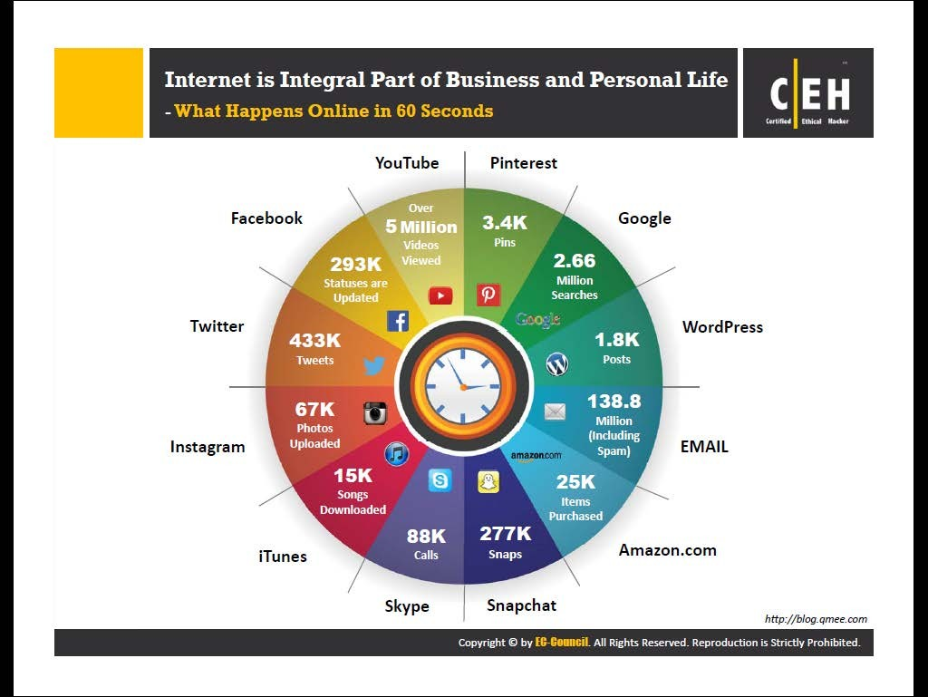

Slide 3
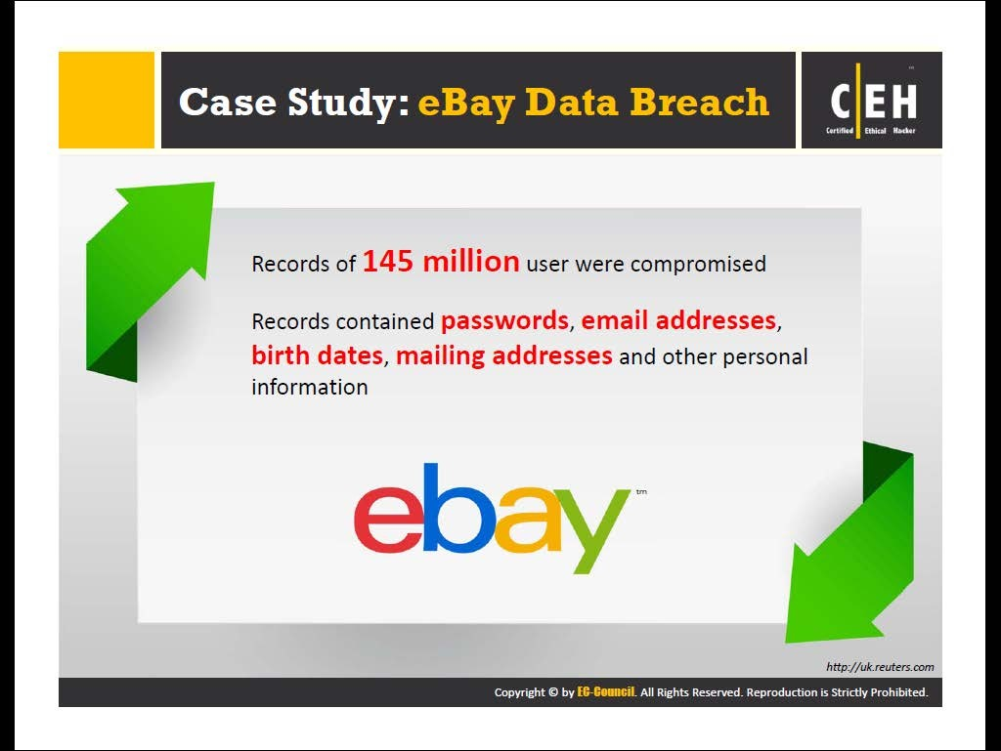

Slide 4
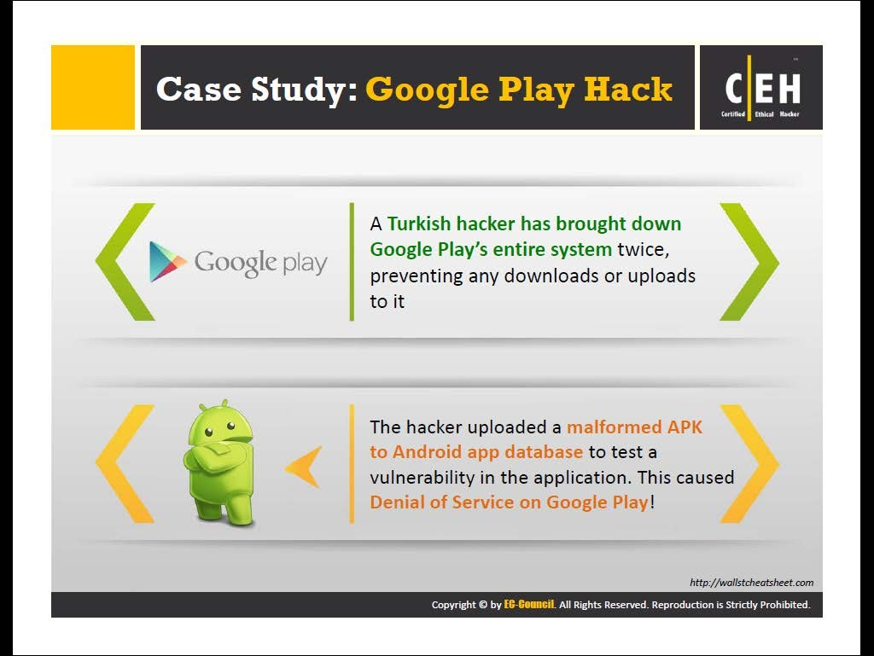

Slide 5
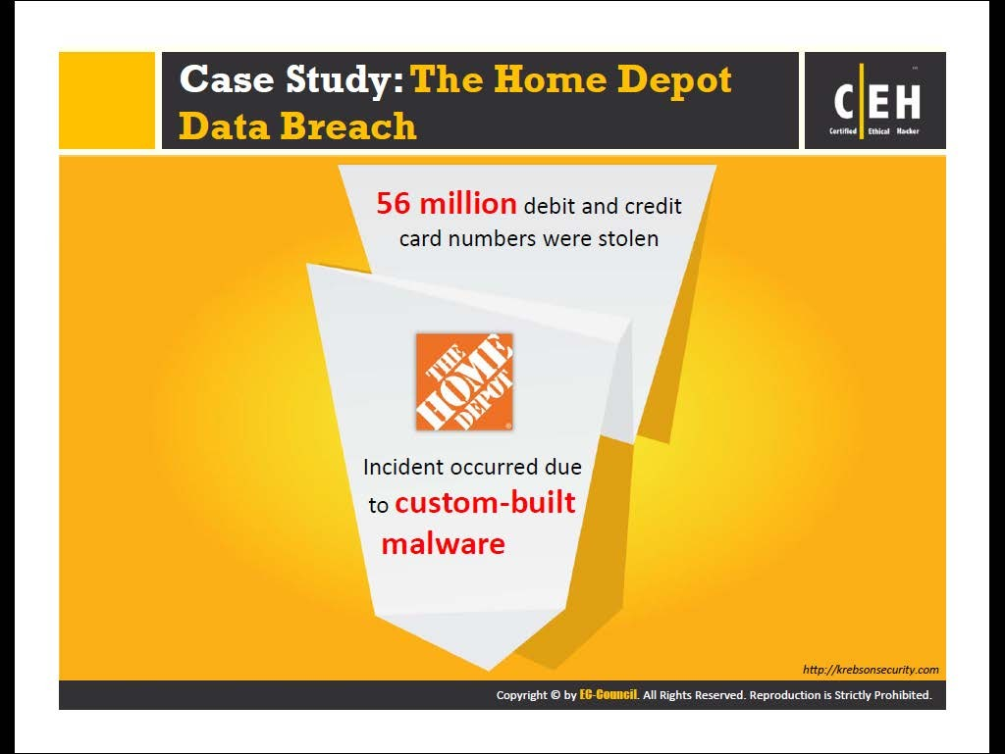

Slide 6
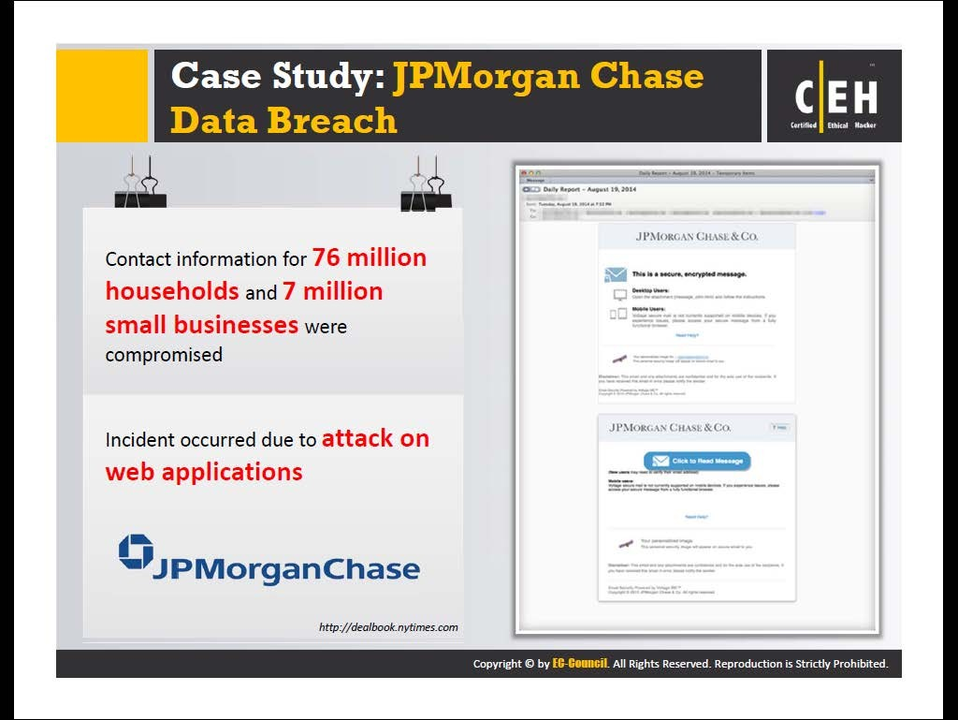

Slide 7
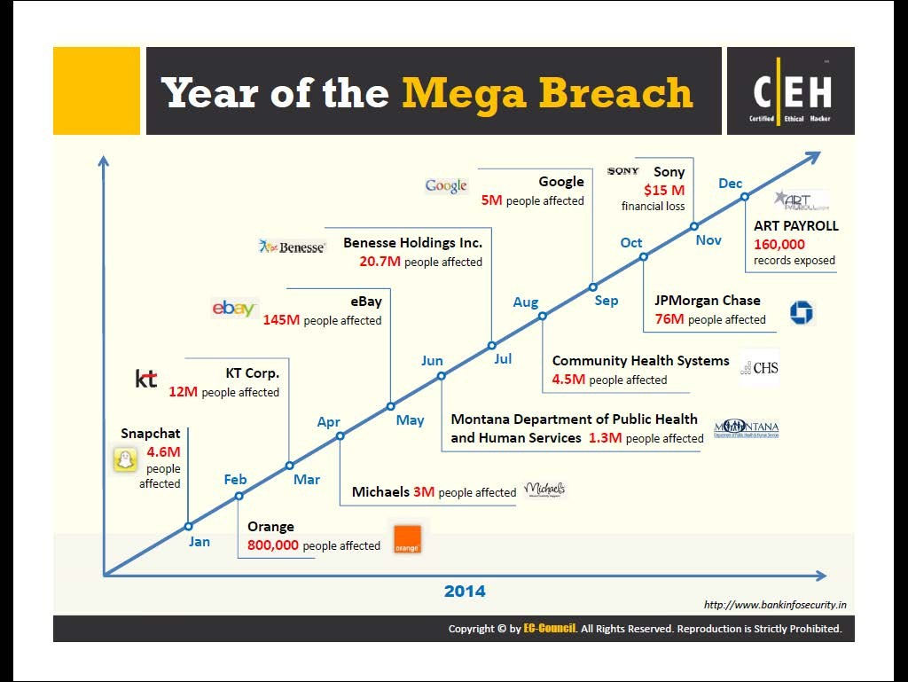

Slide 8
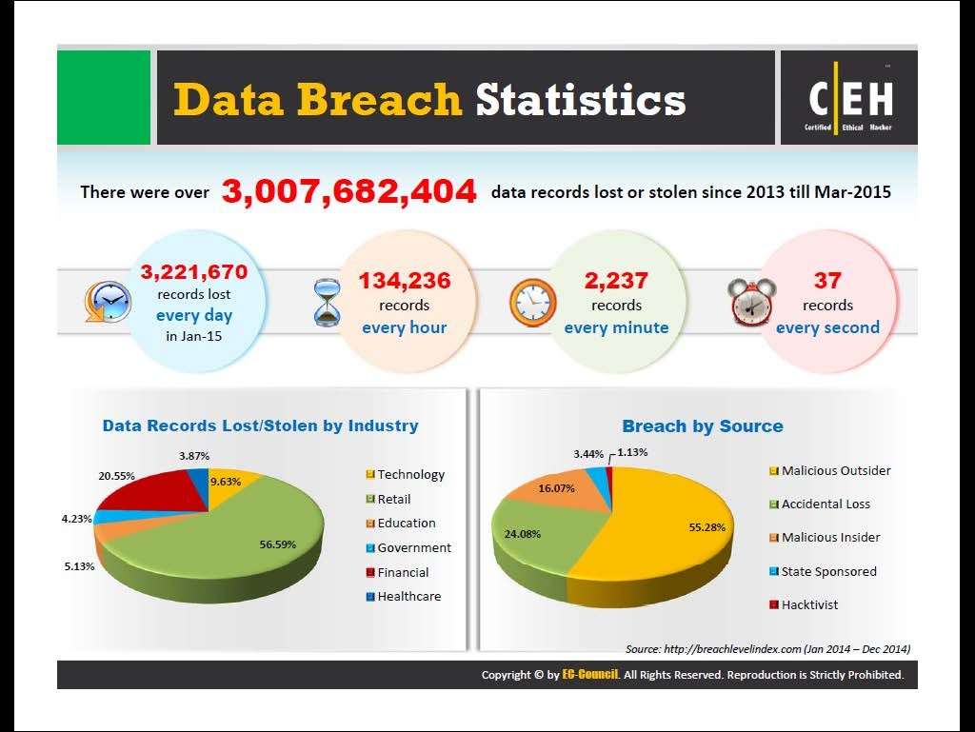

Slide 9
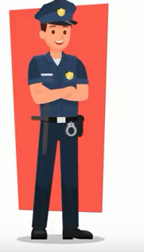
What Is Security?
“A state of being secure and free from danger or harm; the actions taken to make someone or something secure.”
Security is not a ‘thing’ – rather, it is a ‘process.’
--
Notes:
What Is Security?
“A state of being secure and free from danger or harm; the actions taken to make someone or something secure”
A successful organization should have multiple layers of security in place to protect:
Operations
Physical Infrastructure
People
Functions
Communications
Information

Slide 10
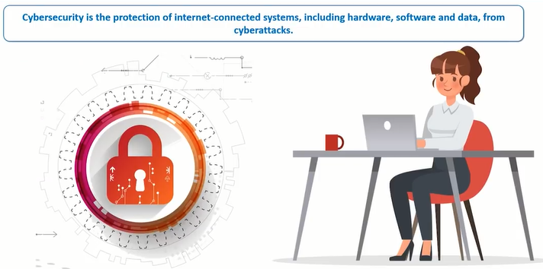
Cyber Security?

Slide 11
Cyber security?
Cyber security is the protection of Internet connected system, including hardware, software, and program or data from cyber attacks.
Precautions taken to guard against unauthorized access to data (in electronic form) or information systems connected with internet
Prevent crime related to Internet

Slide 12
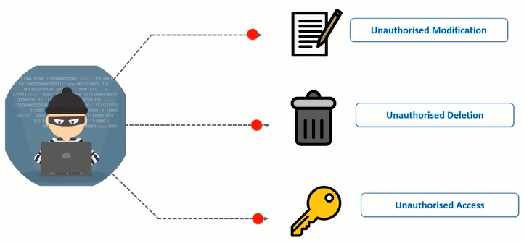
Protect Against What?

Slide 13
CIA TRIAD (Video)
https://www.youtube.com/watch?v=rwigKjEsdTc

Slide 14
C.I.A. triangle or Security Objectives
Confidentiality
“Preserving authorized restriction on information access and disclosure, including means for protecting personal privacy and proprietary information.”
Integrity
“Guarding against improper information modification or destruction, and includes ensuring information non-repudiation and authenticity.”
Availability
“Ensuring timely and reliable access and use of information.”
Notes:
Non-repudiation is the assurance that someone cannot deny the validity of something. Non-repudiation is a legal concept that is widely used in information security and refers to a service, which provides proof of the origin of data and the integrity of the data

Slide 15
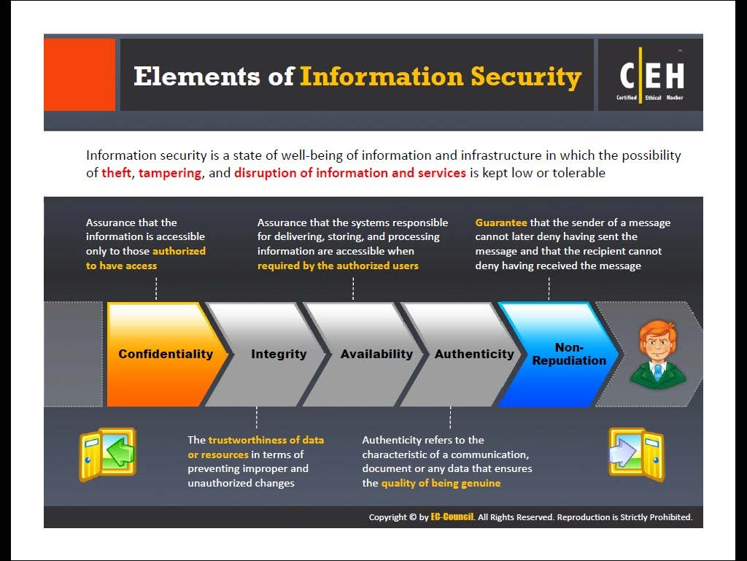

Slide 16
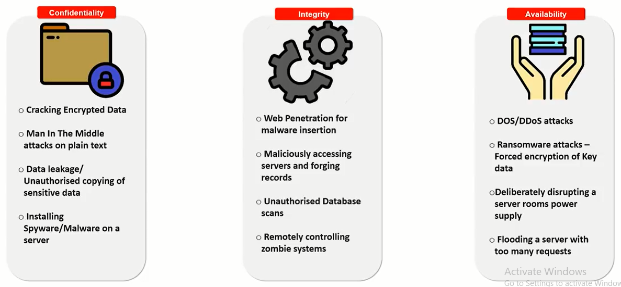
Attacks on CIA

Slide 17
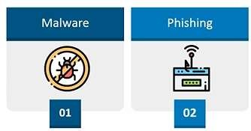
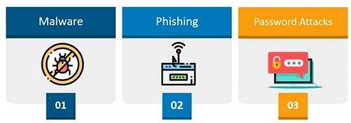
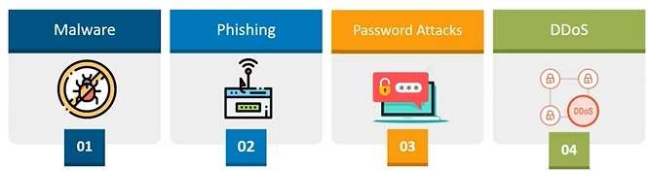
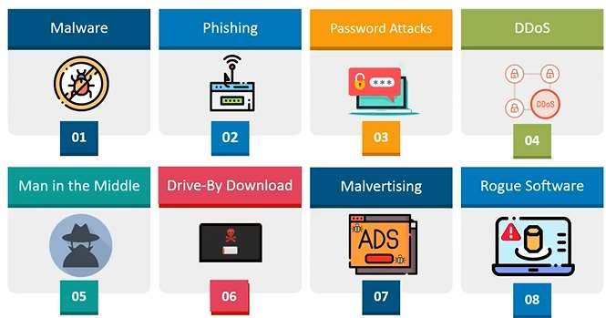
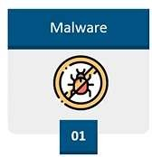
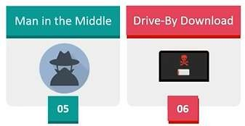
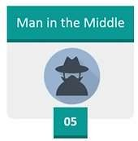
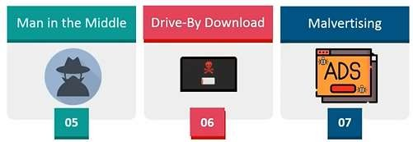
Types of Attacks

Slide 18
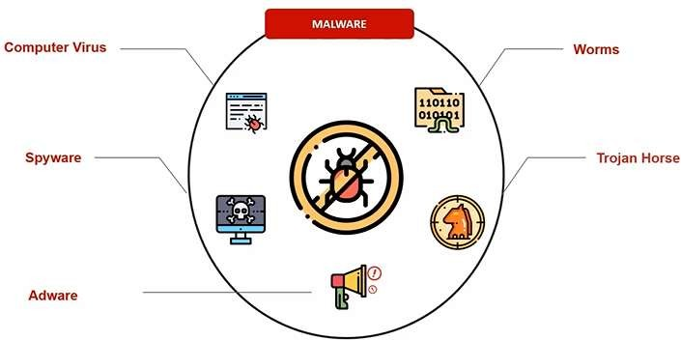
Malware
Notes:
computer worm is a standalone malware computer program that replicates itself in order to spread to other computers.

Slide 19
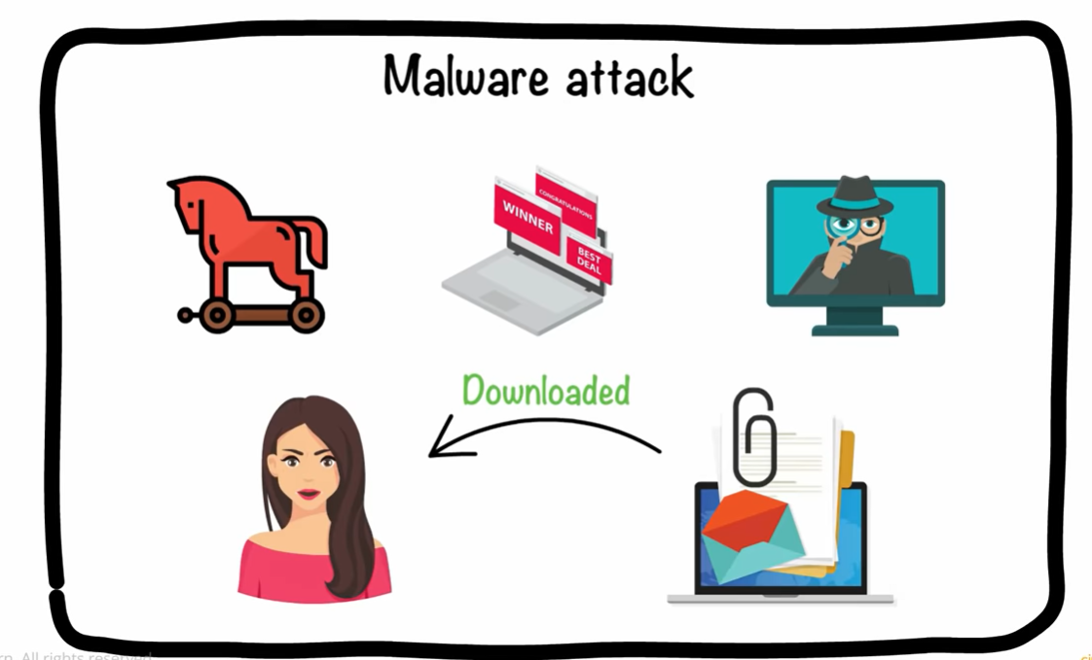

Slide 20
Malware
Spyware
The most rapidly growing types of malware
Cookies
Key logger
Notes:
Spyware is the most rapidly growing type of malware.
Cookies: initially a good idea to help users surf the Web, now misused to spy on users
Key logger: both in software and hardware, captures all the user’s typing and logs it, capturing passwords, account numbers, credit card numbers, etc.

Slide 21
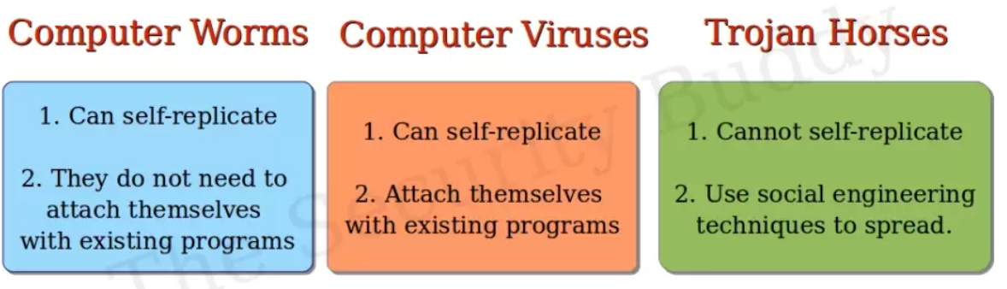

Slide 22
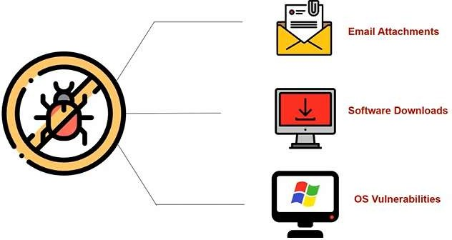
How Malware

Slide 23
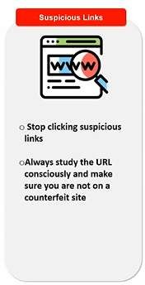
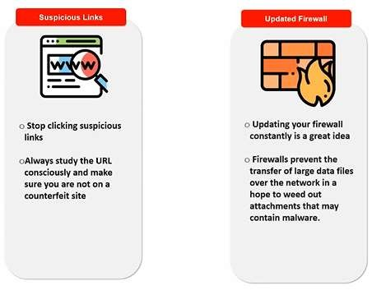
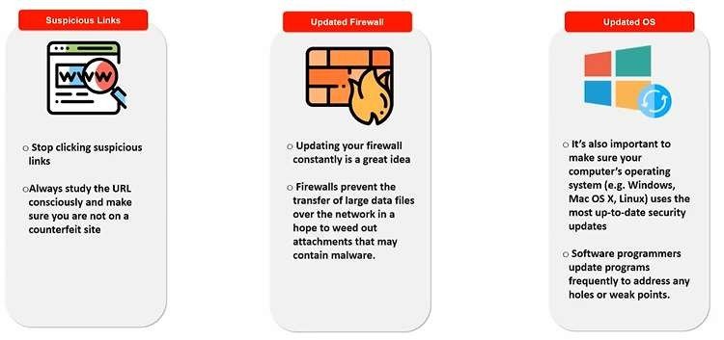
How to Stop?

Slide 24
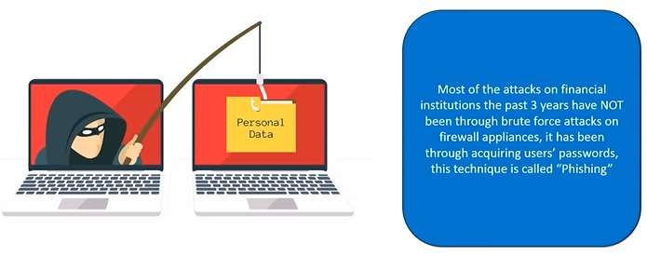
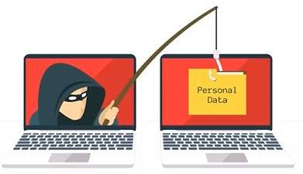
Phishing Attack

Slide 25
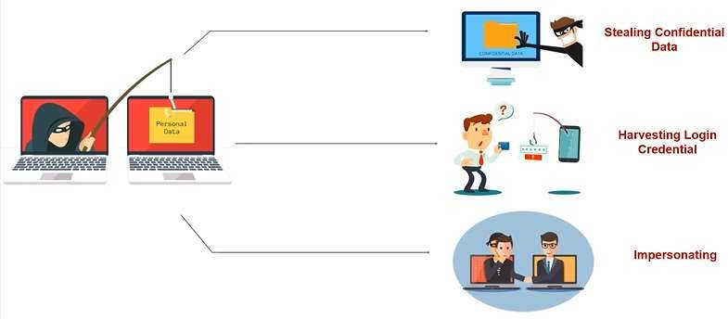
What is Phishing used for?
40

Slide 26
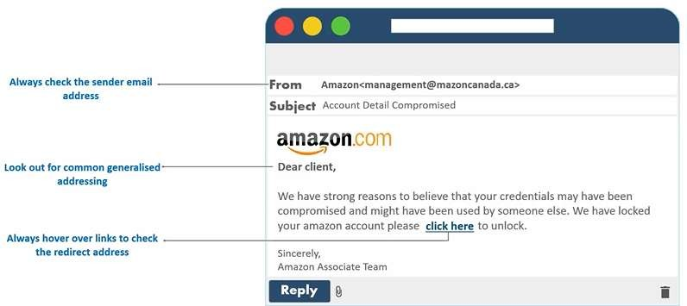
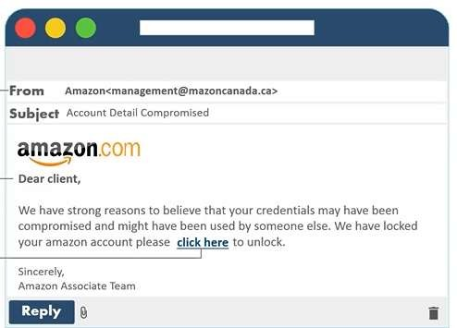
Phishing Awareness

Slide 27
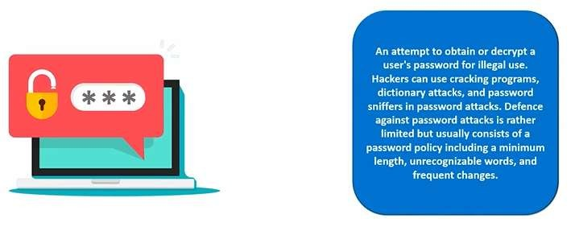
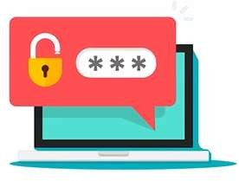
Password Attacks

Slide 28
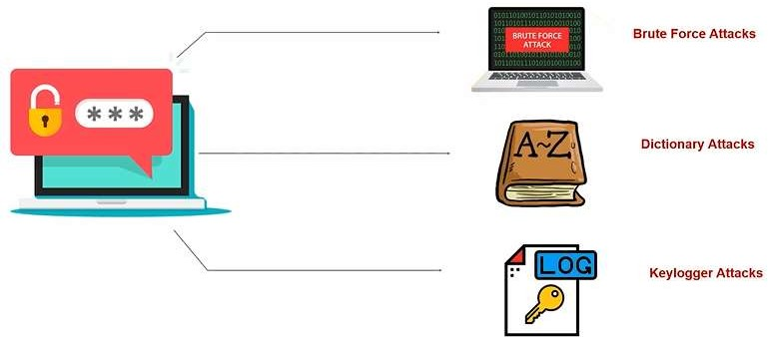
Types of Password Attacks

Slide 29
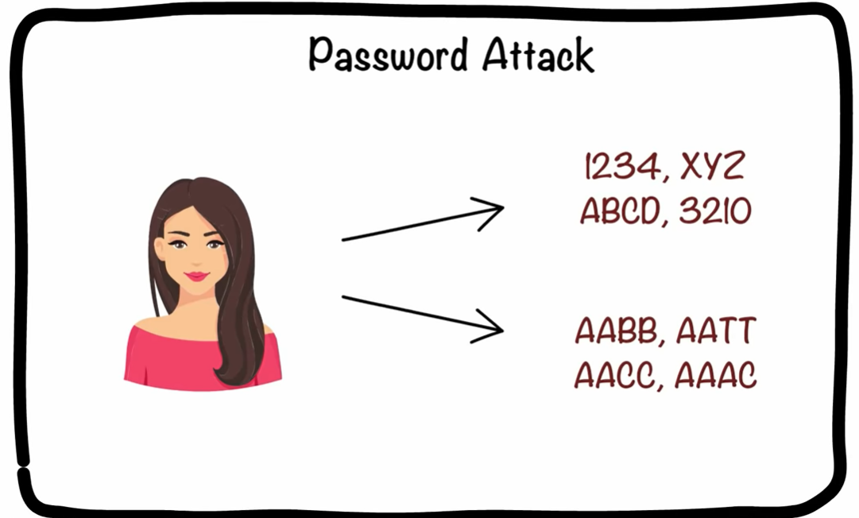

Slide 30
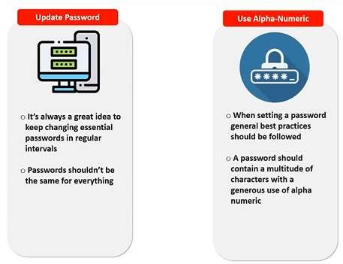
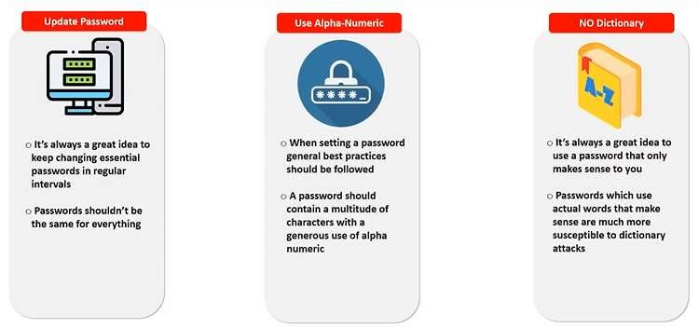
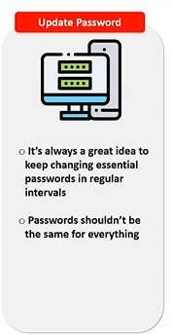
Stop Password Attacks

Slide 31
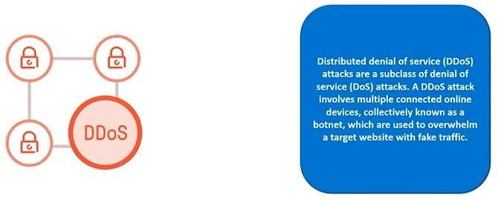
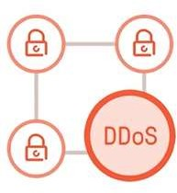
Distributed Denial of Services (DDoS)

Slide 32

Denial of Service Attacks
The attacker does not intrude into the system but just blocks access by authorized users.
Notes:
The attacker does not actually intrude into the system, just blocks access from authorized users
Keeps your customers from purchasing on your Web site, denying you sales
Keeps your employees from purchasing e-tickets to a trade show, making them use a travel agent, which costs more money than you had planned
Keeps you from transferring the money from your business Line of Credit to your business account to pay for the tickets, causing your account to be overdrawn

Slide 33
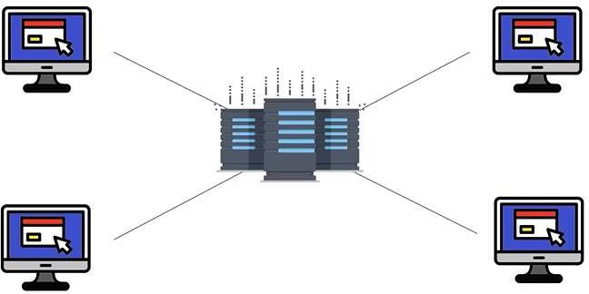
Packet Flood

Slide 34
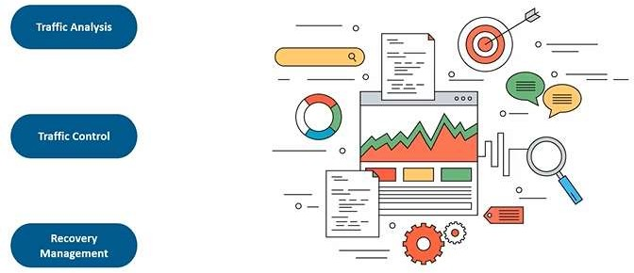
Prevention

Slide 35
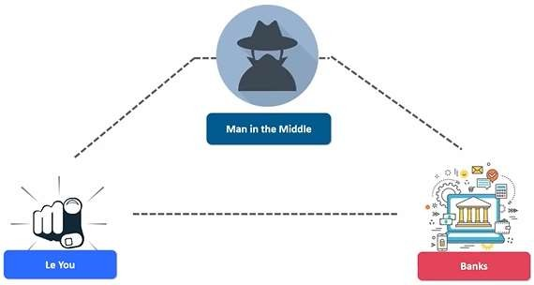
Man in the Middle

Slide 36
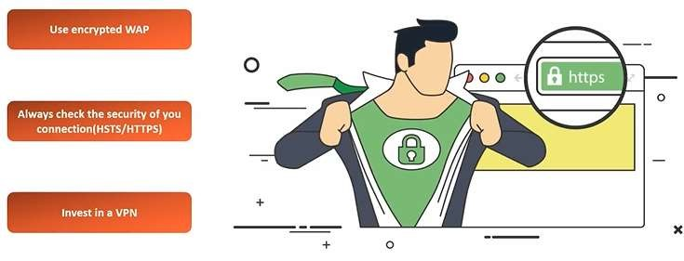
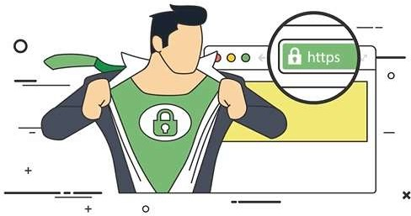
Prevent MITM

Slide 37
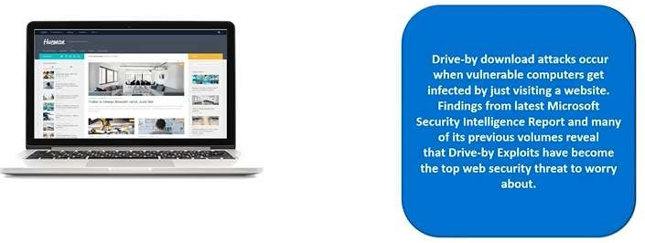
Drive-by Download
50

Slide 38
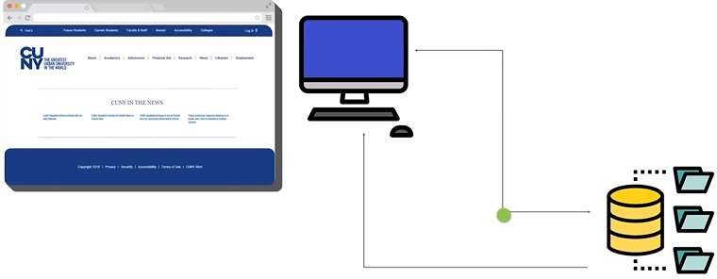
How it work?

Slide 39
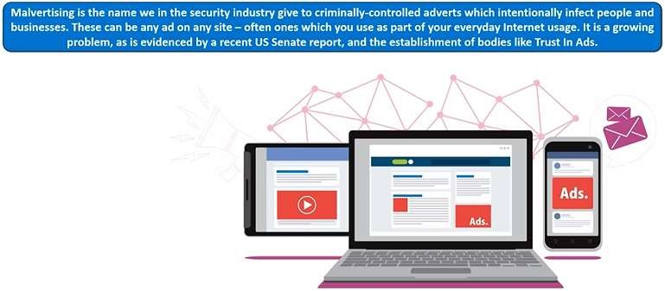
Malvertising

Slide 40
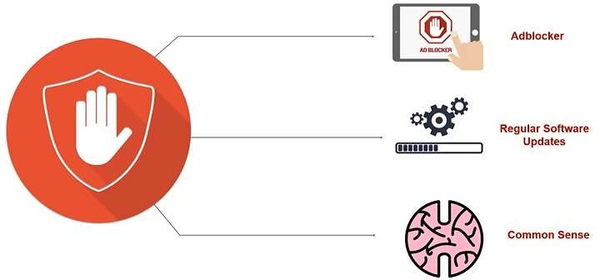
Prevention

Slide 41

Rogue Software

Slide 42

Propagation

Slide 43

Prevention

Slide 44
Web Attacks
The attacker attempts to breach a web application. Common attacks of this type are SQL injection
Notes:
The attacker does not actually intrude into the system, just blocks access from authorized users
Keeps your customers from purchasing on your Web site, denying you sales
Keeps your employees from purchasing e-tickets to a trade show, making them use a travel agent, which costs more money than you had planned
Keeps you from transferring the money from your business Line of Credit to your business account to pay for the tickets, causing your account to be overdrawn

Slide 45


Slide 46
Session Hijacking
This is a complex attack that involves actually taking over an authenticated session.
Notes:
The attacker does not actually intrude into the system, just blocks access from authorized users
Keeps your customers from purchasing on your Web site, denying you sales
Keeps your employees from purchasing e-tickets to a trade show, making them use a travel agent, which costs more money than you had planned
Keeps you from transferring the money from your business Line of Credit to your business account to pay for the tickets, causing your account to be overdrawn

Slide 47
DNS Poisoning
This involves altering DNS records on a DNS server to redirect client traffic to malicious websites, usually for identity theft.
Notes:
The attacker does not actually intrude into the system, just blocks access from authorized users
Keeps your customers from purchasing on your Web site, denying you sales
Keeps your employees from purchasing e-tickets to a trade show, making them use a travel agent, which costs more money than you had planned
Keeps you from transferring the money from your business Line of Credit to your business account to pay for the tickets, causing your account to be overdrawn

Slide 48
Cyber Crime?
Cybercrime, or computer-oriented crime, is a crime that involves a computer and a network. The computer may have been used source of a crime, or it may be the target.

Slide 49




IMPORTANCE OF INFORMATION SECURITY
As per PWC Global Economic Crime Report 2016, Cyber Crime was amongst the top 3 most commonly reported types of economic crime
As per Europol 2013 report, Cyber Crime is now more profitable than the drug trade
Notes:
Pwc PricewaterhouseCoopers

Slide 50
Classification of Cyber Crimes
Insider Attack:
Person with authorized system access
Dissatisfied or unhappy inside employees or contractors
Motive could be revenge or greed
Well aware of the policies, processes, IT architecture and weakness of the security system
Comparatively easy for a insider attacker to steel sensitive information, crash the network, etc.
Could be prevented by using IDS/IPS
External Attack:
Hired by an insider or an external entity to the organization
Organization not only faces financial loss but also the loss of reputation
Attackers usually scan and gathering information
Keeps regular eye on the log and carefully analyzing these firewall logs
IDS/IPS can also protect from external attackers

Slide 51
Classification of Cyber Crimes (Cont.)
Cyber attacks can also be classified as:
Unstructured attacks
Generally person who don't have any predefined motives to perform the cyber attack
Try to test a tool readily available over the internet
Structure attacks:
Performed by highly skilled and experienced people
Motives of these attacks are clear in their mind
Access to sophisticated tools and technologies to gain access to other networks without being noticed
Expertise to develop or modify the existing tools to satisfy their purpose
Usually performed by professional criminals, by a country on other rival countries, politicians to damage the image of the rival person or the country, terrorists, rival companies, etc.
0

Slide 52
Reasons for Commission of Cyber Crimes
Money:
People are motivated towards committing cyber crime is to make quick and easy money.
Revenge:
Take revenge with other person/organization/society/caste or religion
Defaming its reputation or bringing economical or physical loss.
This comes under the category of cyber terrorism.
Fun:
The amateur do cyber crime for fun.
Recognition:
It is considered to be pride if someone hack the highly secured networks
Anonymity:
Anonymity that a cyber space motivates the person to commit cyber crime
Cyber Espionage:
At times the government itself is involved in cyber trespassing to keep eye on other person/network/country

Slide 53
Kinds of Cyber Crimes
Cyber Stalking
Stalking, harassing, threatening someone, or defame a person
The behavior includes false accusations, threats, sexual exploitation to minors, monitoring, etc.
Child Pornography
Possessing image or video of a minor (under 18), engaged in sexual conduct.
Forgery and Counterfeiting
Produce counterfeit which matches the original document
Not possible to judge the authenticity of the document
Software Piracy and Crime related to IPRs:
An illegal reproduction and distribution
Cyber Terrorism
Use of computer resources to intimidate or force government, the civilian population or any segment thereof in furtherance of political or social objectives
Phishing
Acquiring personal and sensitive information of an individual via email
Vishing (voice phishing), Smishing
■

Slide 54
Kinds of Cyber Crimes (Cont.)
Computer Vandalism
Physical destroying computing resources using physical force or malicious code
Computer Hacking
Modifying computer hardware and software to accomplish a goal
Simply demonstrations of the technical ability, to sealing, modifying or destroying information for social, economic or political reasons

Slide 55
Kinds of Cyber Crimes (Cont.)
Creating and distributing viruses over internet
Spreading of an virus can cause business and financial loss
Spamming
Sending of unsolicited and commercial bulk message
Spams not only irritate the recipients and overload the network but also waste the time and occupy the valuable memory space
Cross Site Scripting
Injecting a malicious client side script into a trusted website
Malicious script gets access to the cookies and other sensitive information and sent to remote servers
Online Auction Fraud
Online auction fraud schemes which often lead to either overpayment of the product or the item is never delivered
Cyber Squatting
Reserving the domain names of someone else's trademark
Sell it afterwards at higher price
■

Slide 56

Steps to Fix a Crime

Slide 57


Slide 58


Slide 59


Slide 60


Slide 61


Slide 62


Slide 63


Slide 64


Slide 65


Slide 66


Slide 67


Slide 68

HaCkRhIn0-TeaM

Slide 69


Slide 70

HaCkRhIn0-TeaM

Slide 71


Slide 72


Slide 73


Slide 74


Slide 75
Online Security Resources
CERT
www.cert.org
Microsoft Security Advisor
www.microsoft.com/security/default.mspx
F-Secure
www.f-secure.com
SANS
www.sans.org
Notes:
CERT
Computer Emergency Response Team, sponsored by Carnegie-Mellon University, the first computer incident response team
Microsoft Security Advisor
Microsoft security information, tools, and updates
F-Secure
Information on virus outbreaks
SANS
Documentation on computer security issues

Slide 76


Slide 77
Basic Network Utilities
Ipconfig
Ipconfig -?
Ipconfig/all
Ipcongig/flushdns
Ipconfig/displaydns
Ping
Ping www.yahoo.com
Ping -?
Tracert
Tracert www.yahoo.com

